Slide 1
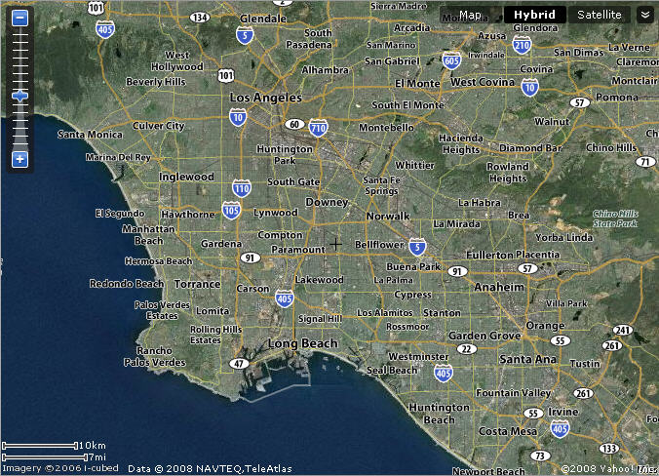







To Ventura
3 MAJOR AIRPORTS
NEAR NWS SEAL BEACH
To San Diego

Slide 2
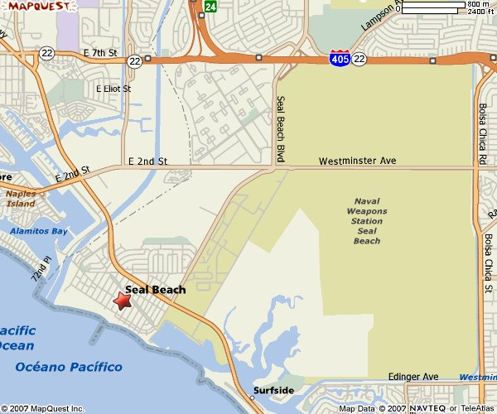



GATE
FORRESTALL
RETURN TO AIRPORT MAP

Slide 3
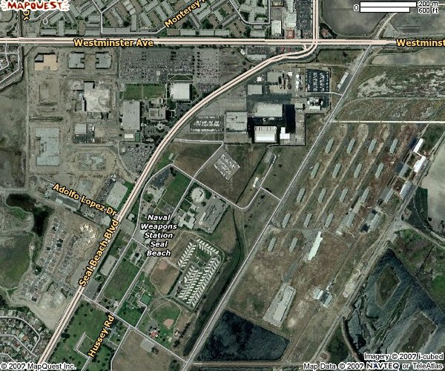
BLDG 10
GYM
BLDG 200
(Pass & ID)
Forestall
RETURN TO AIRPORT MAP

